Slide 1
Example of Project Diary

Slide 2
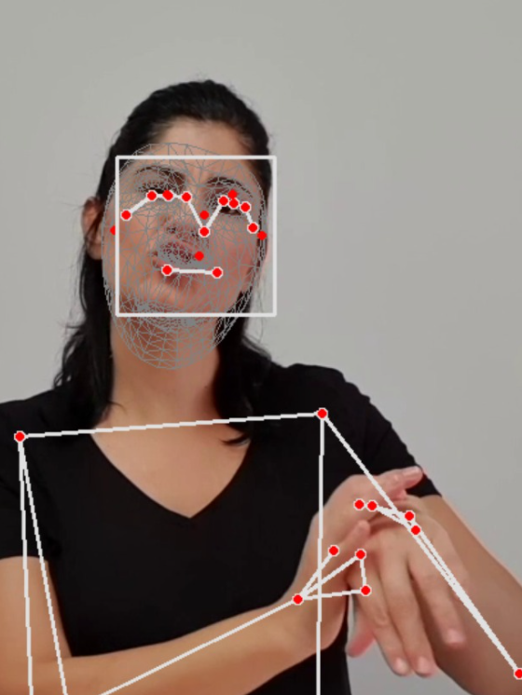
Predicting emotion from facial expressions in
signers vs coders vs hearing subjects
Collaborator : Dr Rose Stamp – linguistics dept – Sign Language
Notes:
Project 3: Title Page

Slide 3
f1: X,y,z
f2: X,y,z
f3: X,y,z
fn: X,y,z
f1: X,y,z
f2: X,y,z
f3: X,y,z
fn: X,y,z
Notes:
Project 3: intro

Slide 4
7.3.21
Approaches:
1. openface -> AU’s
2. use openface to generate data to train a classifier to map media pipe’s landmarks to Au’s
End goal:
Use AU’s to determine significant features in singers
How much those Au’s are affected by speech
Notes:
Project 3: about page

Slide 5
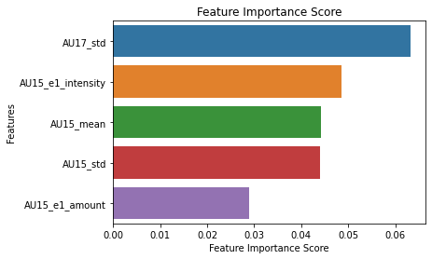
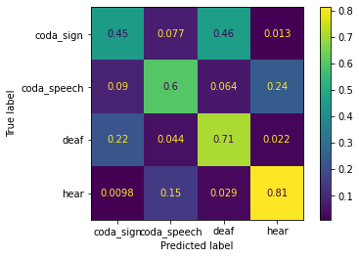
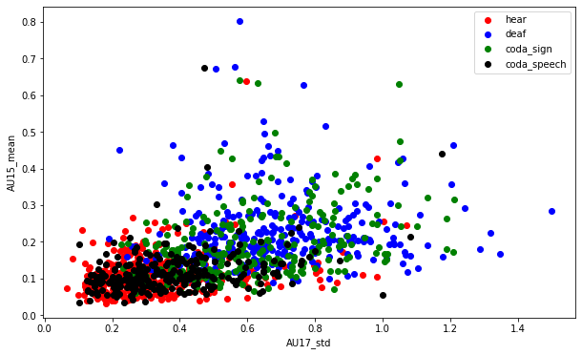
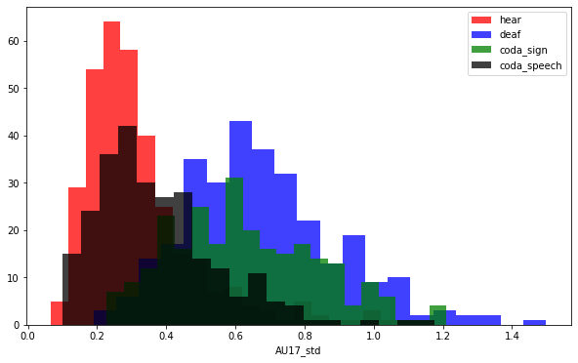
1.2.23
Task1 –classify groups – coda vs deaf vs hear
New Data is fixed - 1159 samples / videos – hear 340, deaf 300, coda_speech 259, coda_sign 260
Accuracy: 0.65. CV score 0.56
Notes:
This slide shows results of a trained model with 4 classes:
Confusion matrix
Feature ranking
Histogram of 1 feature value (diff color for the different classes )
Distribution plot of 2 feature values (diff color for each class)

Slide 6
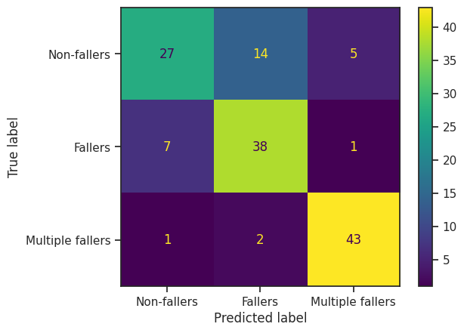
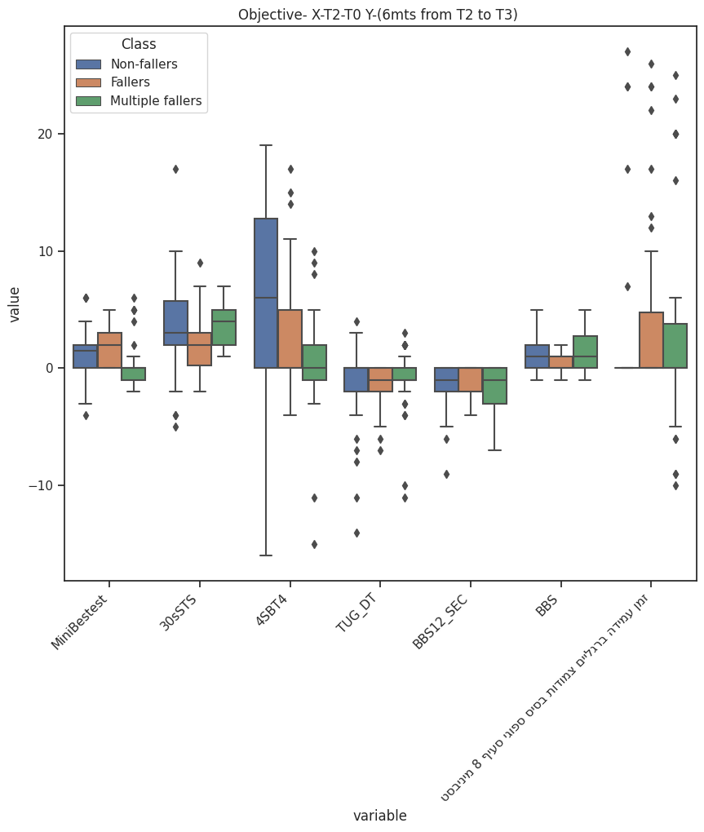
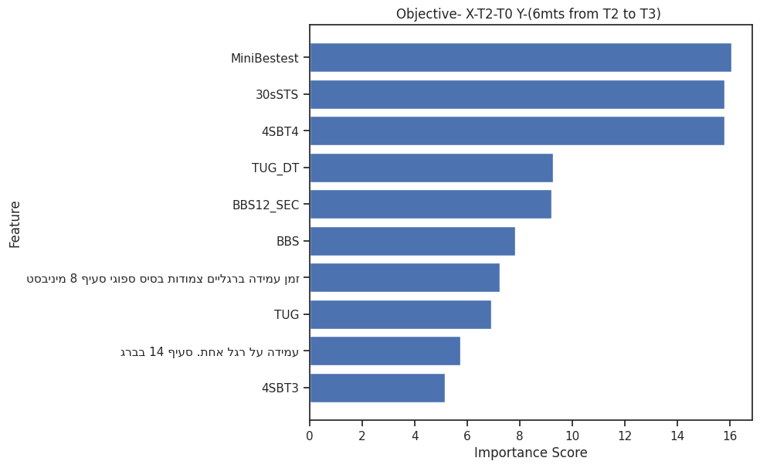
Objective- X-T2-T0 Y-(6mts from T2 to T3)
Model description: Sum of M7-M12
Final - Number of features: 10, Accuracy: 0.818841
Notes:
Example slide from Project #7.
Slide shows results of a trained model with 4 classes:
Confusion matrix
Feature ranking
Box plot with the top ranking features (left to right)

Slide 7
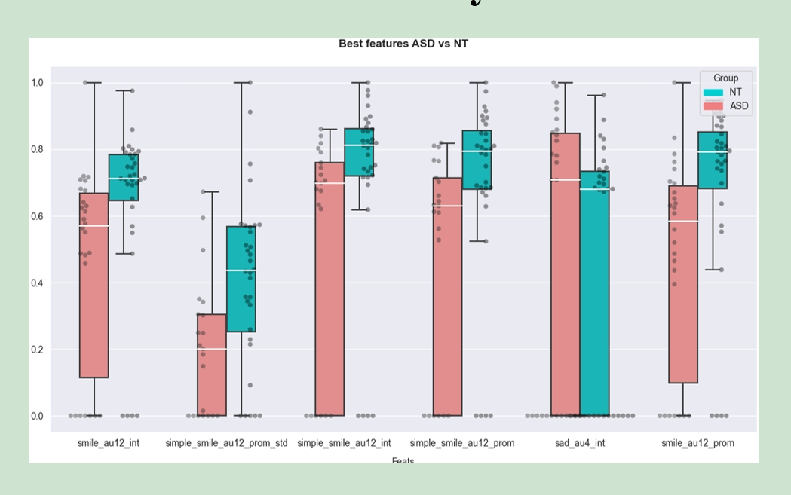
Another BoxPlot (from Project 6)

Slide 8
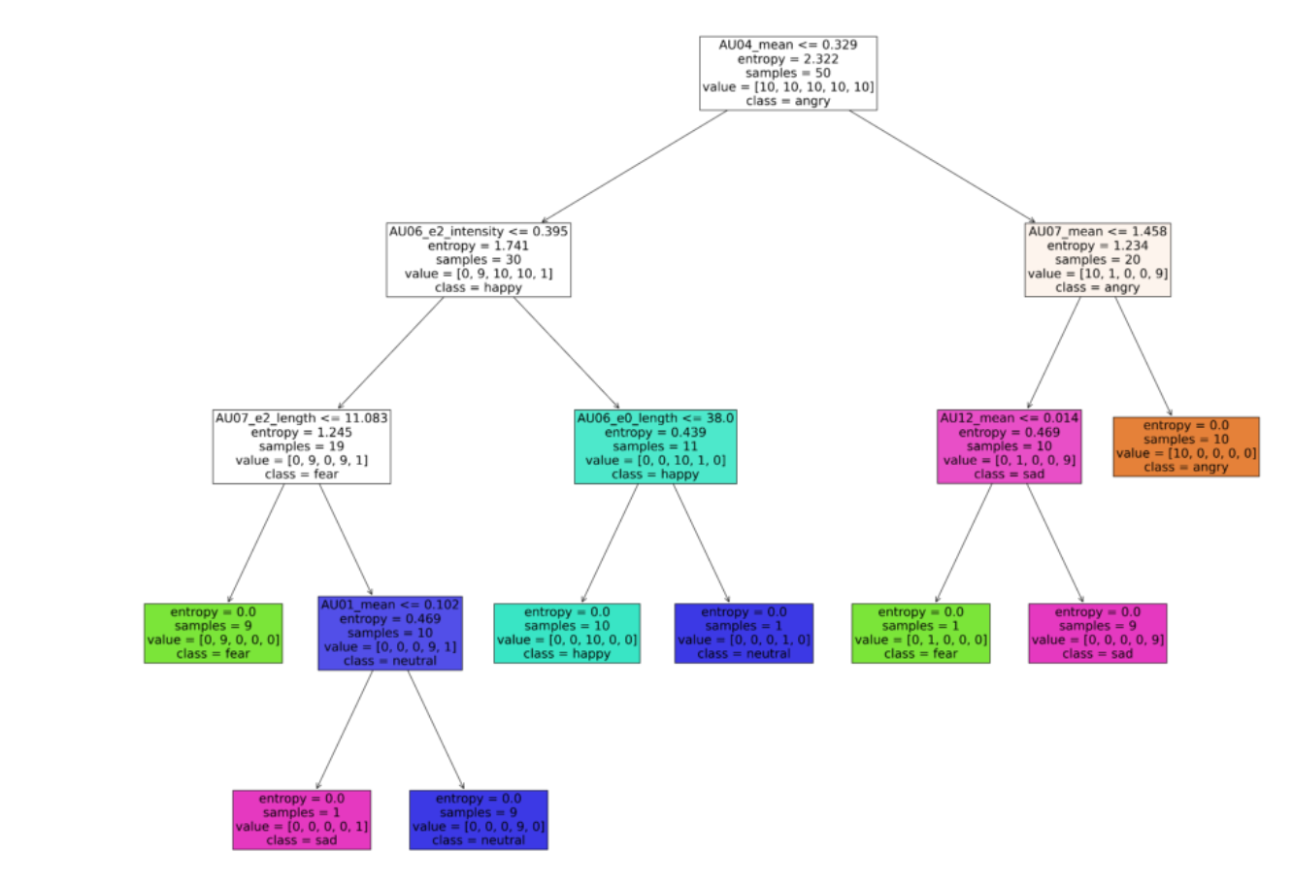
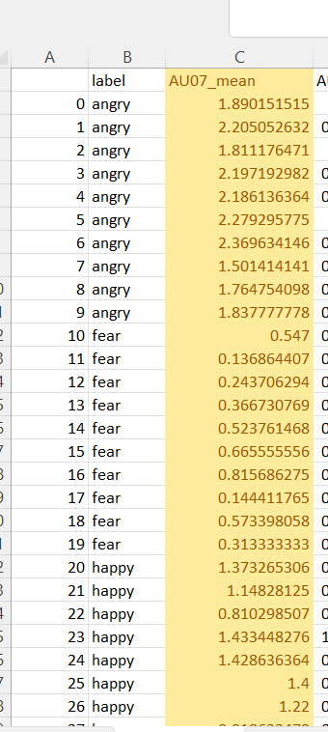
25.4
Some basic classification tells us
Which are the strong features:
AU’s: 1, 4, 7, 6, 12
Notes:
Example of training the tree on PER1 data – 50 vids

Slide 9
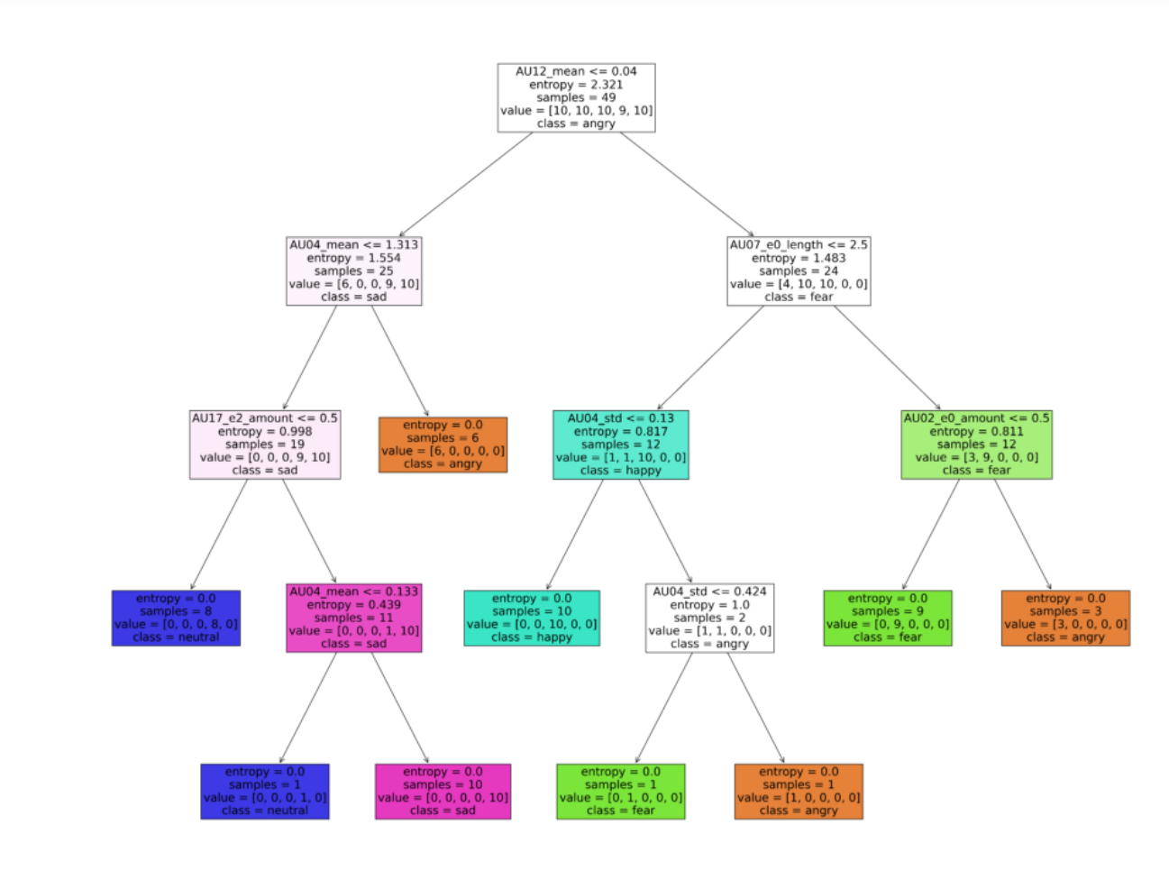
11.5
Hearing – classification using all features:
  CV mean results: 0.64
  AU’s: 2, 4, 7, 12, 17
  ['angry','fear','happy', 'neutral', 'sad']
Notes:
Example of training the tree on PER1 data – 50 vids
['angry','fear','happy', 'neutral', 'sad']

Slide 10
Another Example of Project Diary

Slide 11

Comparing Emotional Expression Across Hearing, Deaf, and CODA Individuals
Hana Hasan, Michael Rodel
Supervisors: Prof. Hagit Hel-Or, Rose Stamp, Svetlana Dachkovsky
Notes:
Example Diary Project 3: Collaborator Dr Rose stamp

Slide 12
Introduction
Emotional expression is a crucial aspect of human communication, and it can vary across individuals with different hearing abilities. It is influenced by various factors, including cultural, cognitive, and physiological aspects, as well as individual differences such as hearing abilities. Understanding how emotional expression differs across individuals with different hearing abilities can provide valuable insights into the complex interplay between communication and hearing.

Slide 13
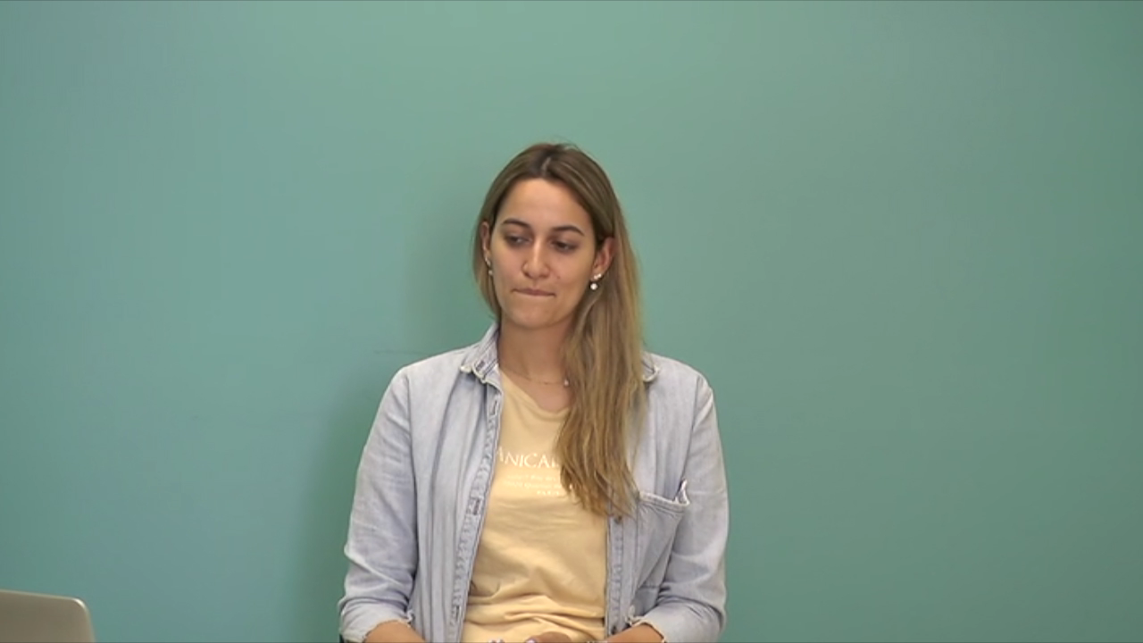
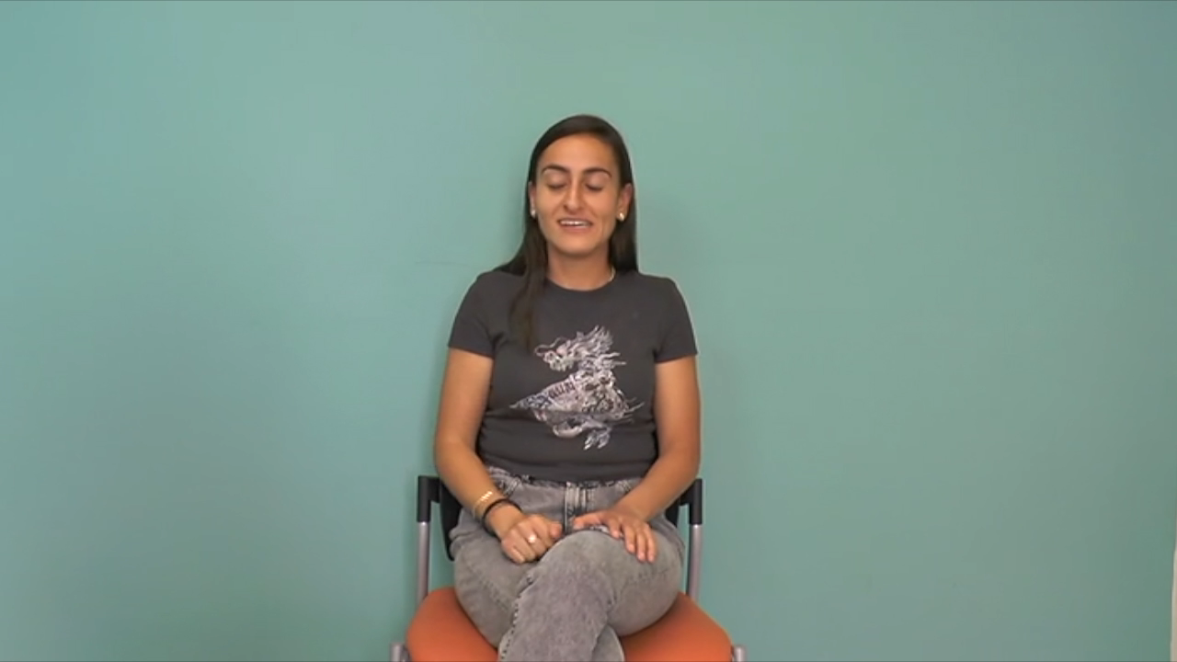
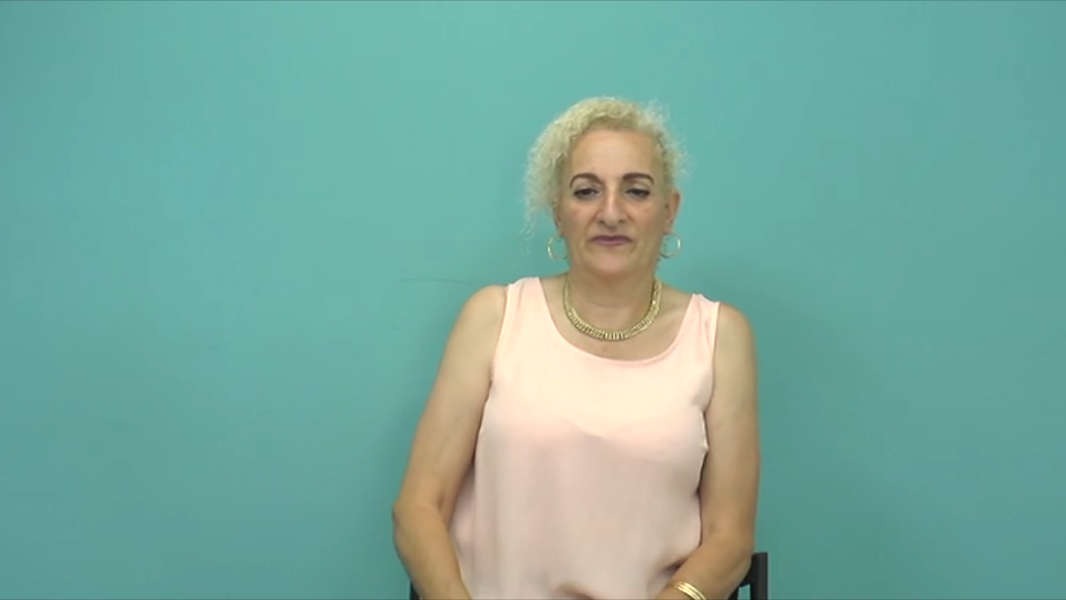
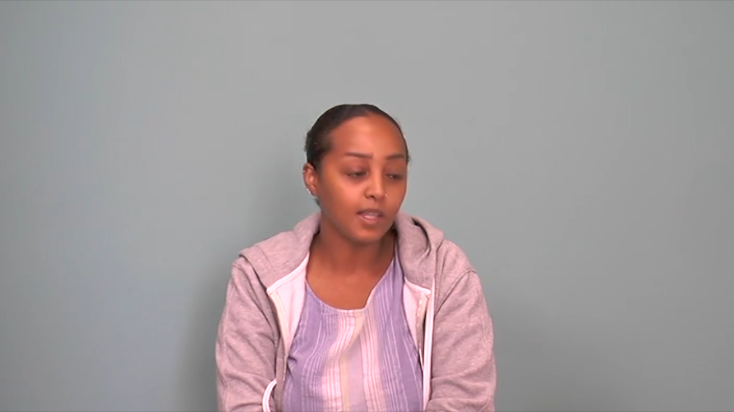
Motivation
In this study, we aim to compare emotional expression across three distinct groups: hearing individuals, deaf individuals, and CODA (Children of Deaf Adults) individuals.
Hearing individuals rely primarily on speech, while deaf individuals primarily use sign language for communication. CODA individuals, on the other hand, have been exposed to both speech and signing from early childhood due to their deaf parents, resulting in unique language and communication experiences.

Slide 14
Data
A controlled experiment was conducted to acquire data.
The data consists of short videos of hearing people talking, deaf people signing and CODA people doing both.
Each video has a duration of approximately 3-6 seconds.
Emotion labeling was done for each video, with 4 different emotions:
Neutral, Happy, Sad and Angry.

Slide 15
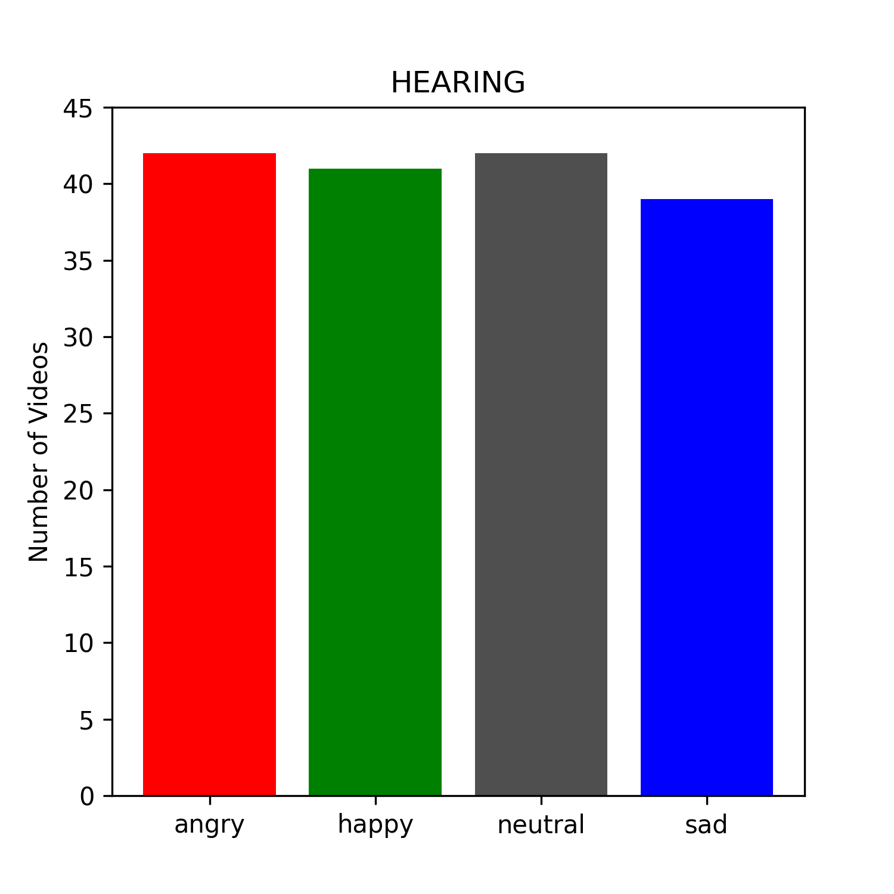
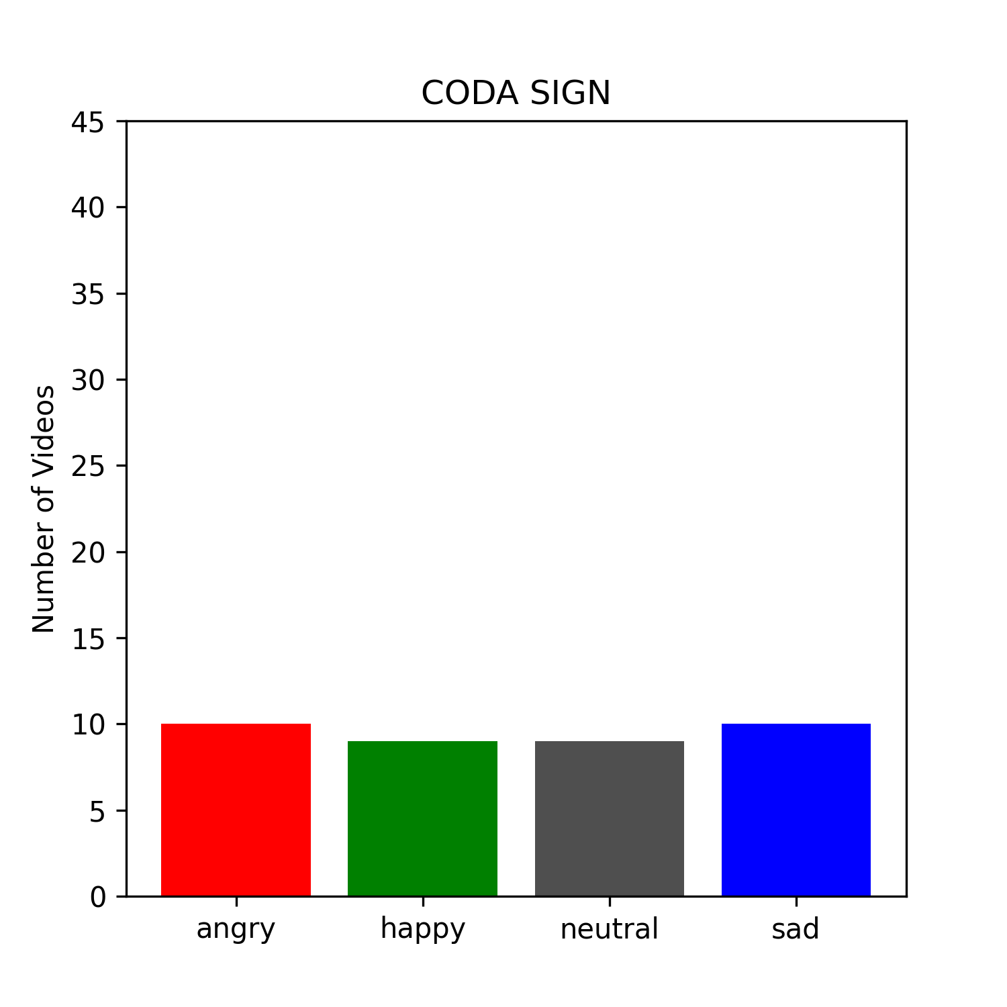
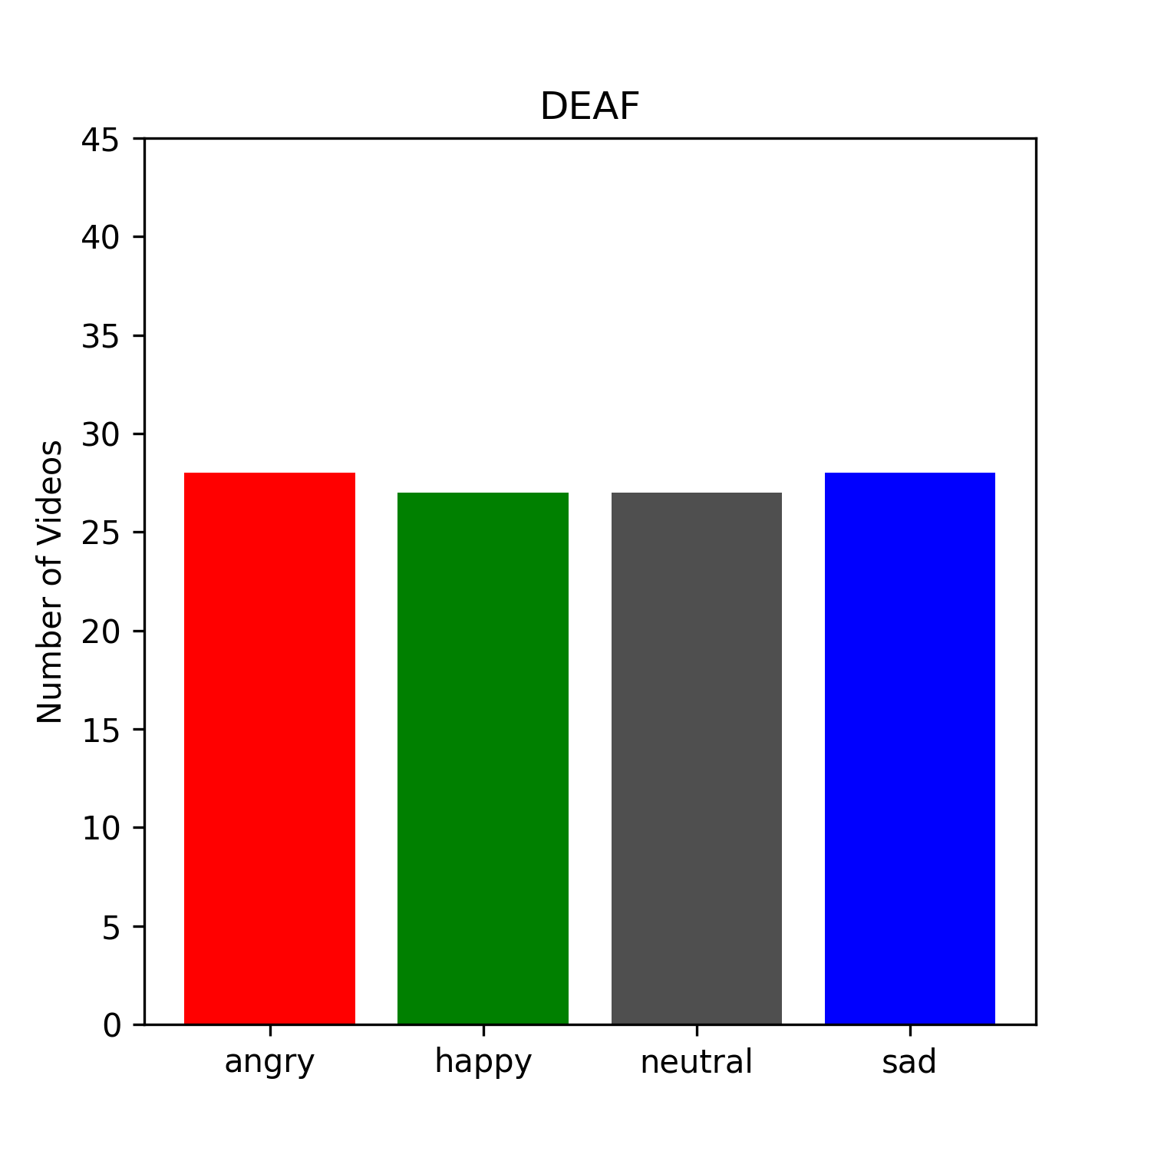
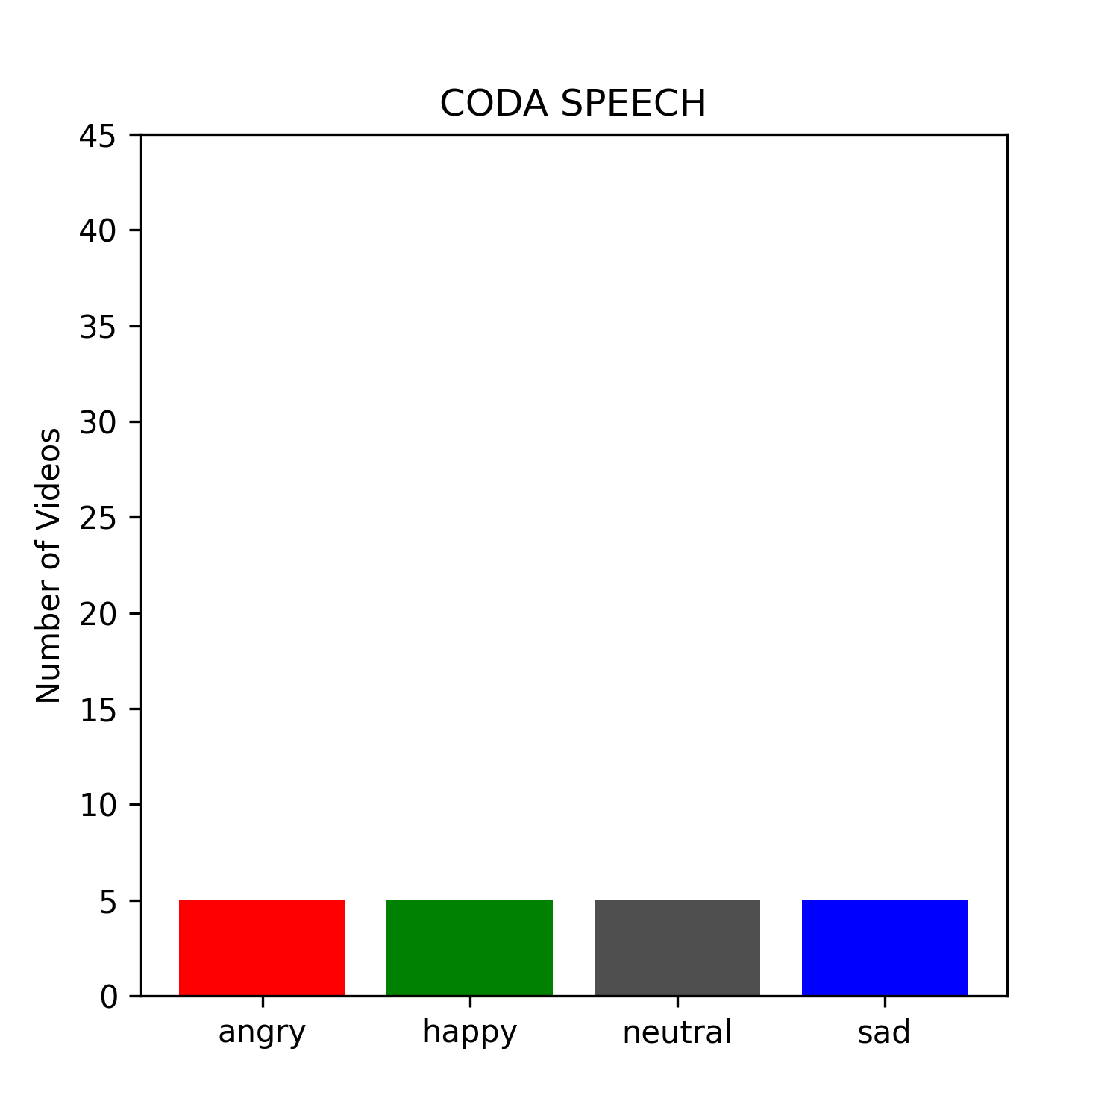
Data Distribution

Slide 16
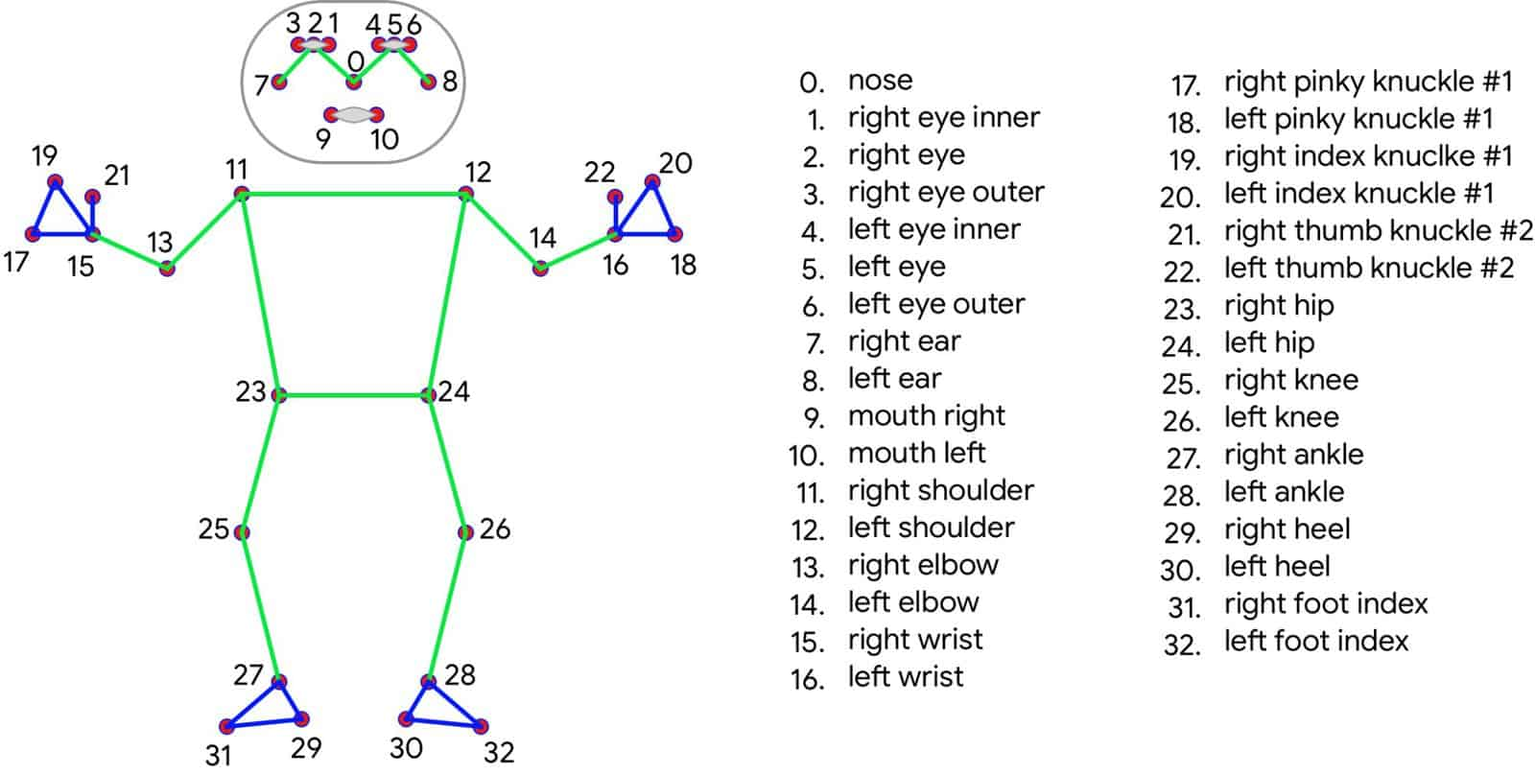
MediaPipe Pose: Advanced Human Pose Estimation Using Deep Learning

Slide 17
MediaPipe Pose: Advanced Human Pose Estimation Using Deep Learning
MediaPipe Pose is an advanced framework developed by Google that employs deep learning techniques to accurately estimate human body poses. With 33 3D landmarks, it provides a high-fidelity representation of body movements.
For our study, we focused on four specific points of interest:
  The right wrist (Landmark 15)
  The left wrist (Landmark 16)
  The midpoint between the eyes (average of Landmarks 2 and 5)
  The midpoint between the shoulders (average of Landmarks 11 and 12)

Slide 18


Landmarks of Interest
Midpoint of the Clavicle (between the shoulders).
Midpoint of the Forehead (between the eyes).
Wrists of both hands.

Slide 19
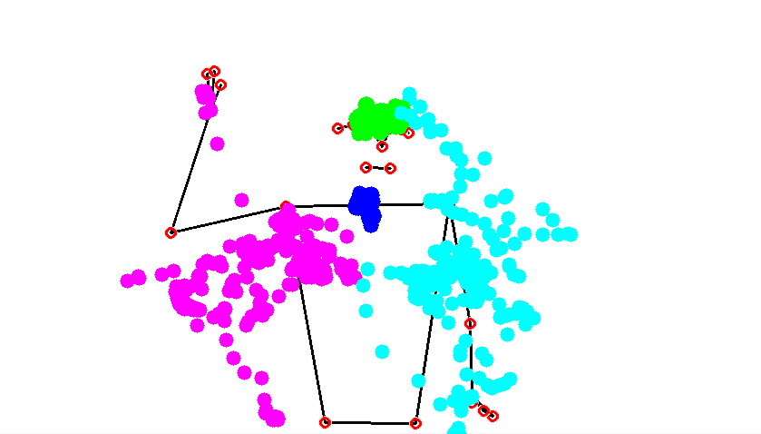
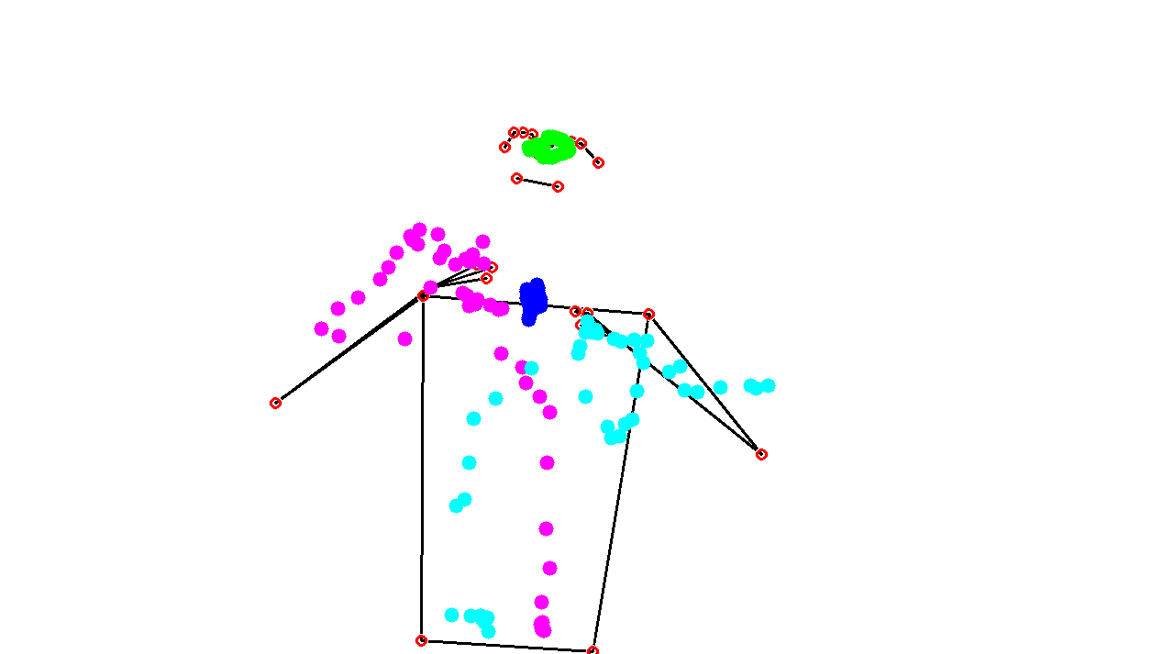
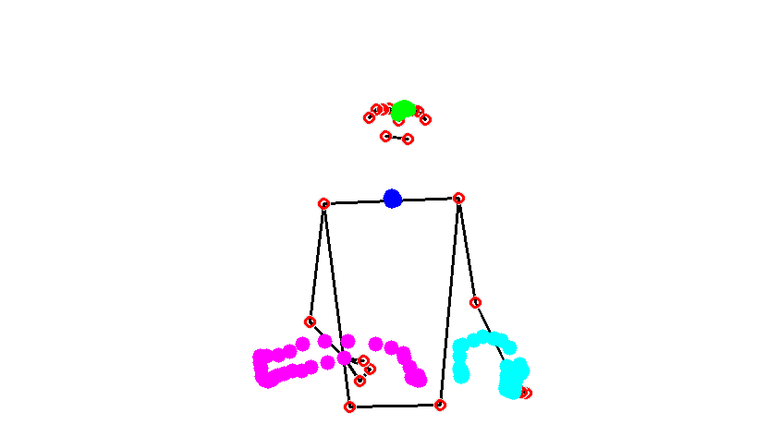
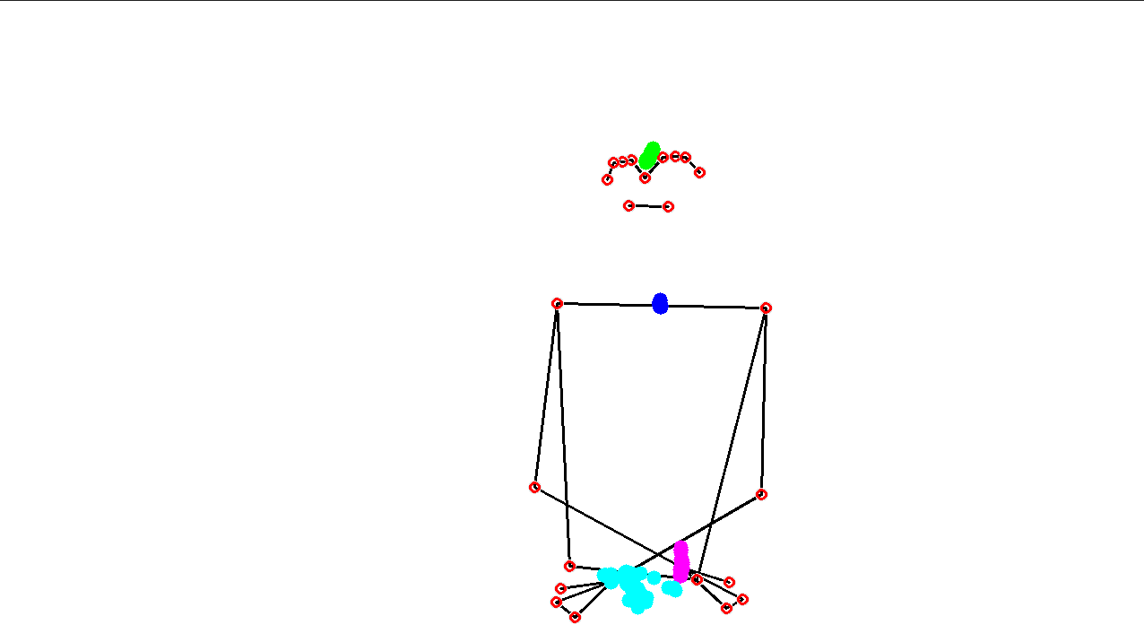
Visualizing Landmarks during Emotional Expression
Angry “You’re wasting my time!” in Hebrew.
D13_14_angry
C01_14_angry_sign
C01_14_angry_speech
per11_14_angry_hearing

Slide 20
Video Processing: A Two-Stage Approach
We introduce a two-stage approach for video processing, designed to extract meaningful features from video frames. The first stage involves processing frame-wise information, while the second stage focuses on aggregating frame information to derive video-wise features.

Slide 21
Frame-wise Processing
We start by identifying four key landmarks in each frame: the left wrist, right wrist, mid eyes, and mid shoulders. From these landmarks, we extract a set of 18 features per frame. These features include the x, y, and z coordinates for each landmark, as well as the Euclidean speed. The Euclidean speed is calculated by measuring the distance between the current frame's coordinates and the coordinates of the previous frame. For the initial frames without a previous frame, the Euclidean speed is set to zero. Additionally, we measure the distance of the wrists from the body plane, which is defined using the mid shoulders, left hip, and right hip landmarks (landmarks 23 and 24 in MediaPipe Pose).
(18 FEATURES: for all landmarks - x, y, z coordinates and Euclidean speed ; only for the two wrists - distance from body plane.)

Slide 22
Aggregation of Frame Information
In the second stage, we aggregate the frame information to derive video-wise features. This process yields a total of 36 features. These features include the variance* of the x, y, and z coordinates across all frames, as well as the largest eigenvalue of the covariance matrix. The covariance matrix represents the relationship between variables (x, y, z) across frames. Computing the largest eigenvalue helps identify the principal component, which indicates the direction of maximum variance. Additionally, we calculate the mean and variance of the speed, the total distance covered by each landmark (sum of all Euclidean distances), and the volume of the 3D movement for each landmark (volume of the convex hull formed by the landmark points). For the wrists, we also compute the mean and variance of the distance from the body plane.
To determine the distinction between the 'Dominant' and 'Non-dominant' wrists, we identified the wrist with the larger volume as the 'Dominant' wrist. Thus, we replaced the labels 'Left' and 'Right' with 'Dominant' and 'Non-dominant' accordingly.
Eventually, we performed data normalization to achieve a standard deviation of 1 and a mean of zero.

Slide 23
Aggregation of Frame Information
(36 FEATURES: for all landmarks - variance of x, y, z coordiantes, largest eigenvalue, mean and variance of speed, volume of the convex hull, total distance covered ; only for the two wrists - mean and variance of distance from body)
* We use the variance instead of the mean because using the mean could introduce bias in the machine learning process. Subjects from different labels might have different mean values simply because of their positions relative to the camera. By using variance, we focus on the spread or dispersion of the data points around the reference point, which allows us to capture the relative differences more accurately and avoid potential biases introduced by positional variations.

Slide 24
Normalization to Baseline and Scaling
In our process of feature normalization, the goal is to bring the features to a common reference point, known as the baseline. This baseline is represented by the "Neutral" label.
Normalization. For each subject, we calculate the average of all sentences' features corresponding to instances labeled as "Neutral." This average, obtained by considering the neutral instances as a whole, represents the characteristic features of the baseline. Next, we perform normalization on each sample of that subject by subtracting the computed average. This process aligns the subject's features with the neutral baseline, ensuring that variations are relative to the neutral reference point.
Scaling. After normalization, we proceed to scale each subject's sample by dividing it by the baseline average. This step allows standardized comparisons across subjects and makes the normalization process relative to the baseline. It represents the normalized features as proportions of their deviation from the average of the "Neutral" instances.

Slide 25
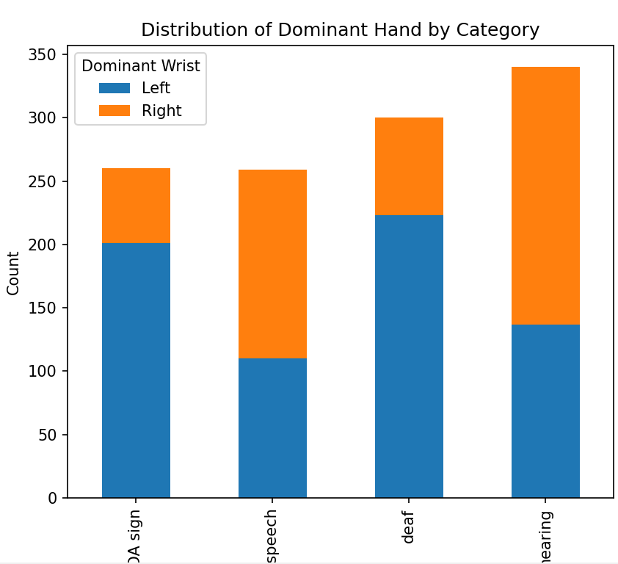
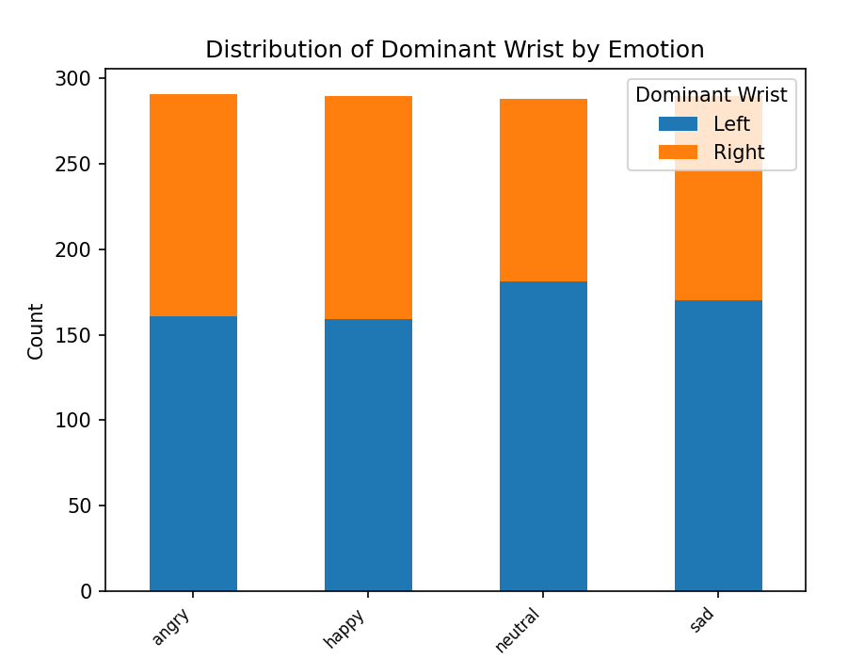
Dominant Wrist (according to Volume)

Slide 26
Classification Results

Slide 27
Emotion Classifier
We utilize a random forest classifier comprised of 100 trees. In order to emulate a balanced dataset, we adjust the weights assigned to each class in inverse proportion to their frequencies in the input data. For each execution, we select a different subset of our categories, including hearing, deaf, CODA sign, and CODA speech, as our data. To assess the performance of our model, we employ an 80-20 random split for training and testing, and utilize a 5-fold technique to evaluate the results on the hold-out test set. This technique involves averaging accuracy over the 5 folds and summing the confusion matrix. Our classifier takes in 36 numeric features extracted from the video processing stage as input, with the target variable being the emotion (anger, sadness, happiness, or neutrality).

Slide 28
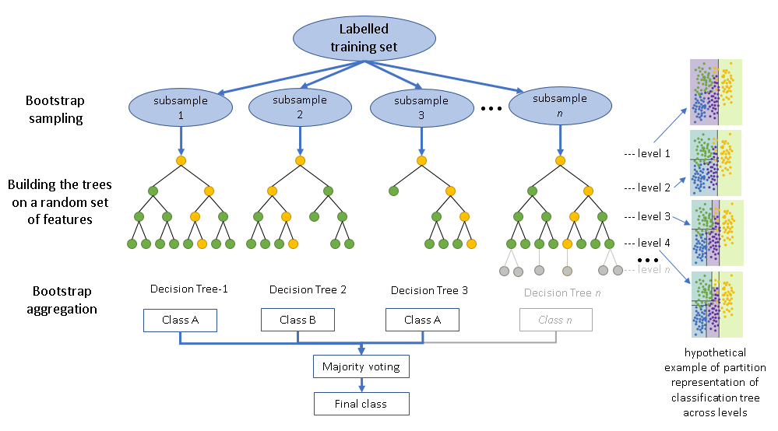

Slide 29
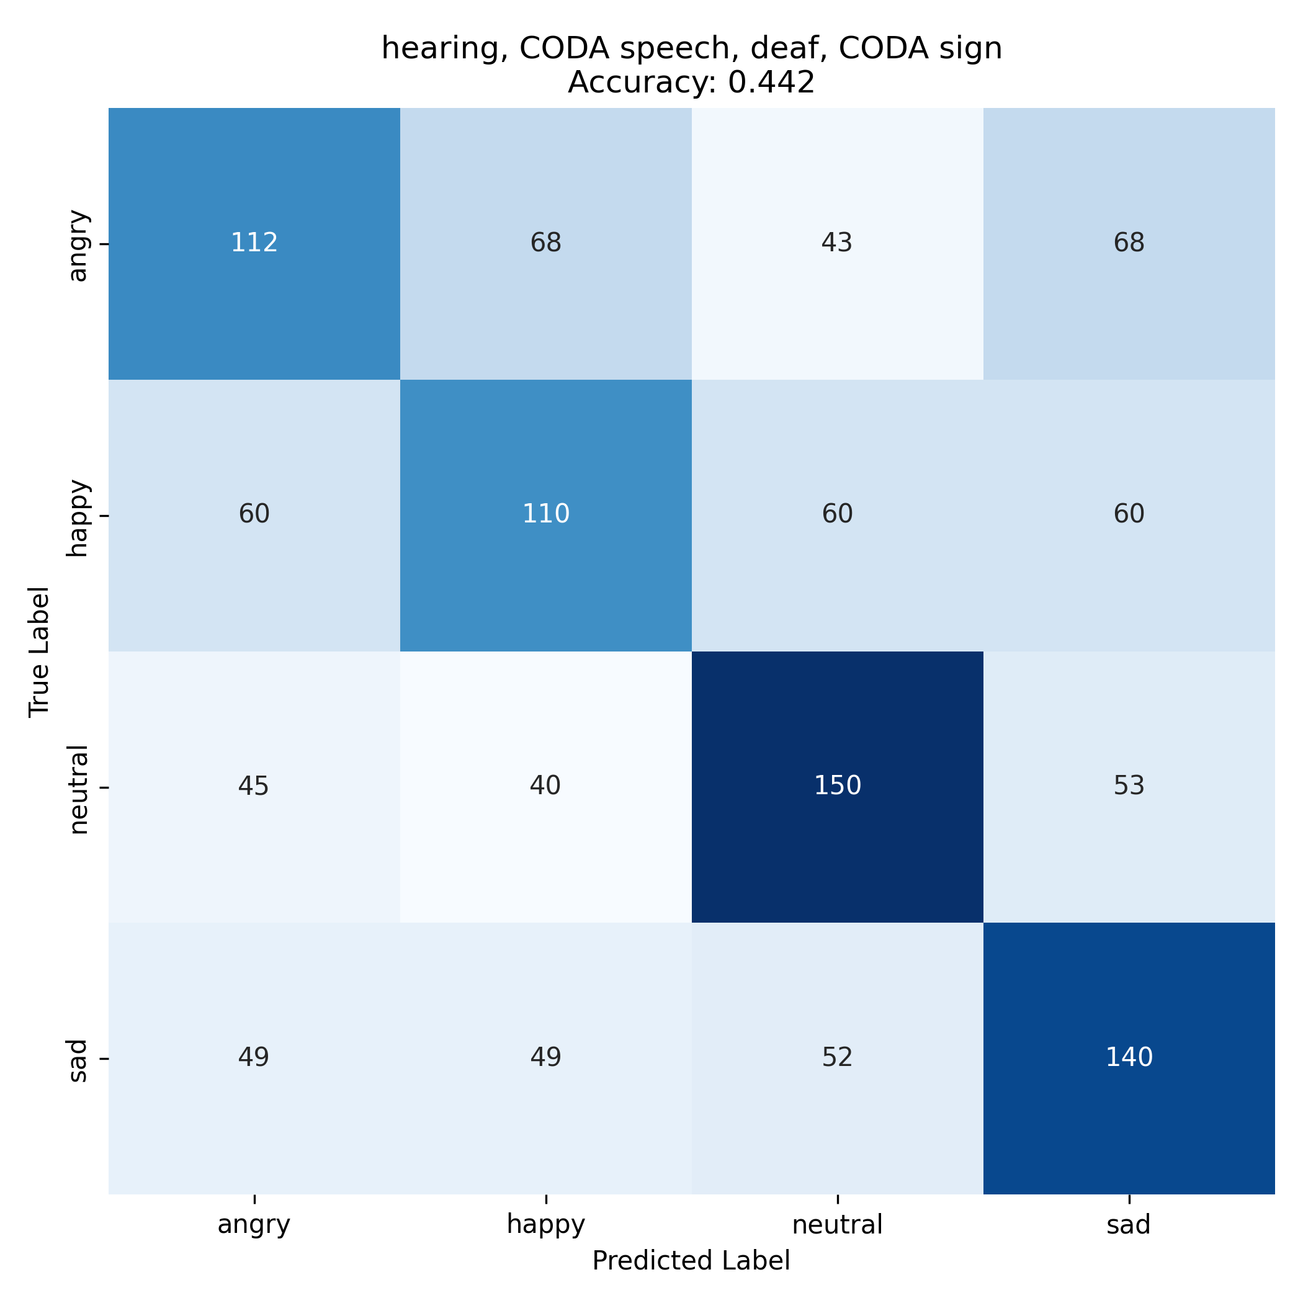
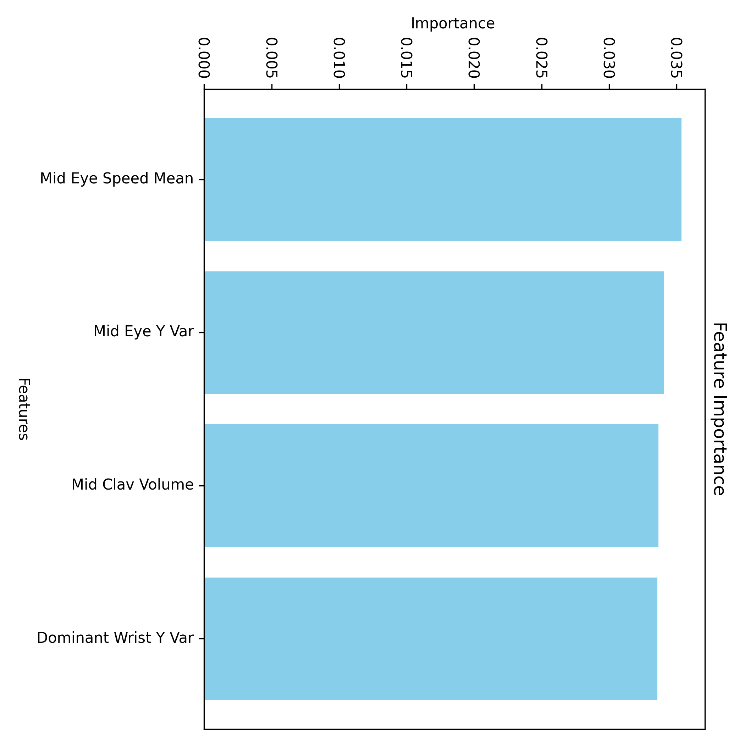
An all-category emotion classifier

Slide 30
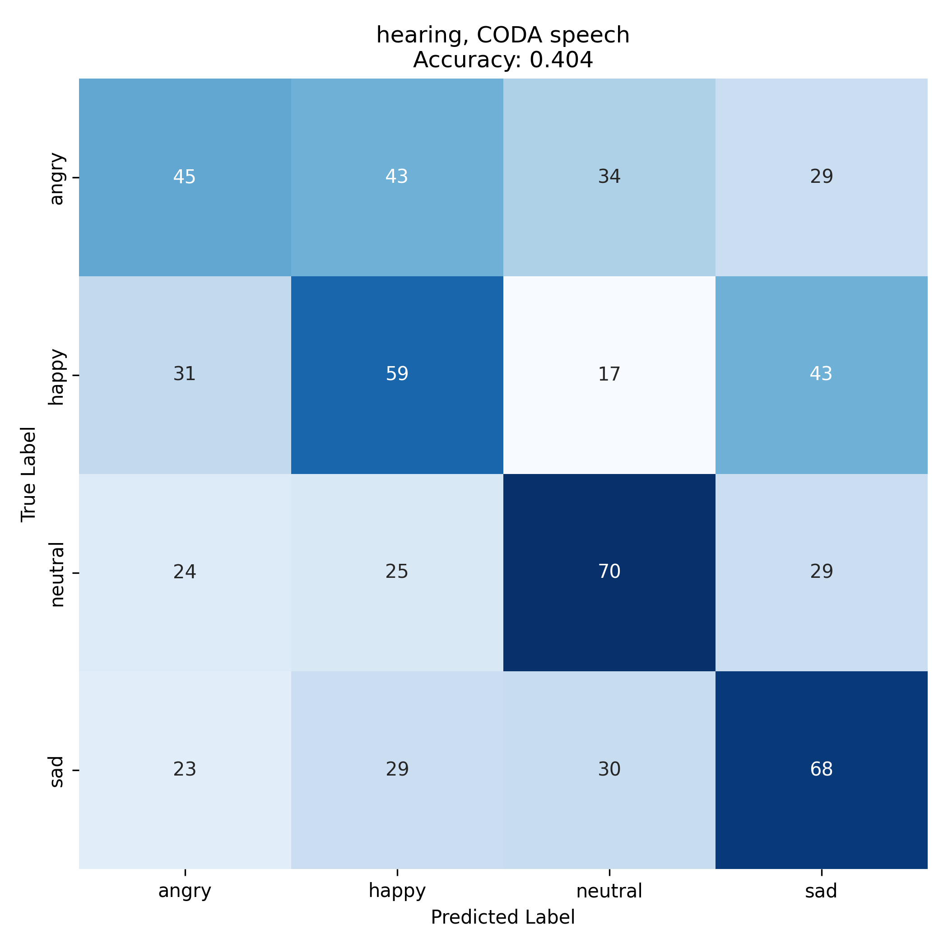
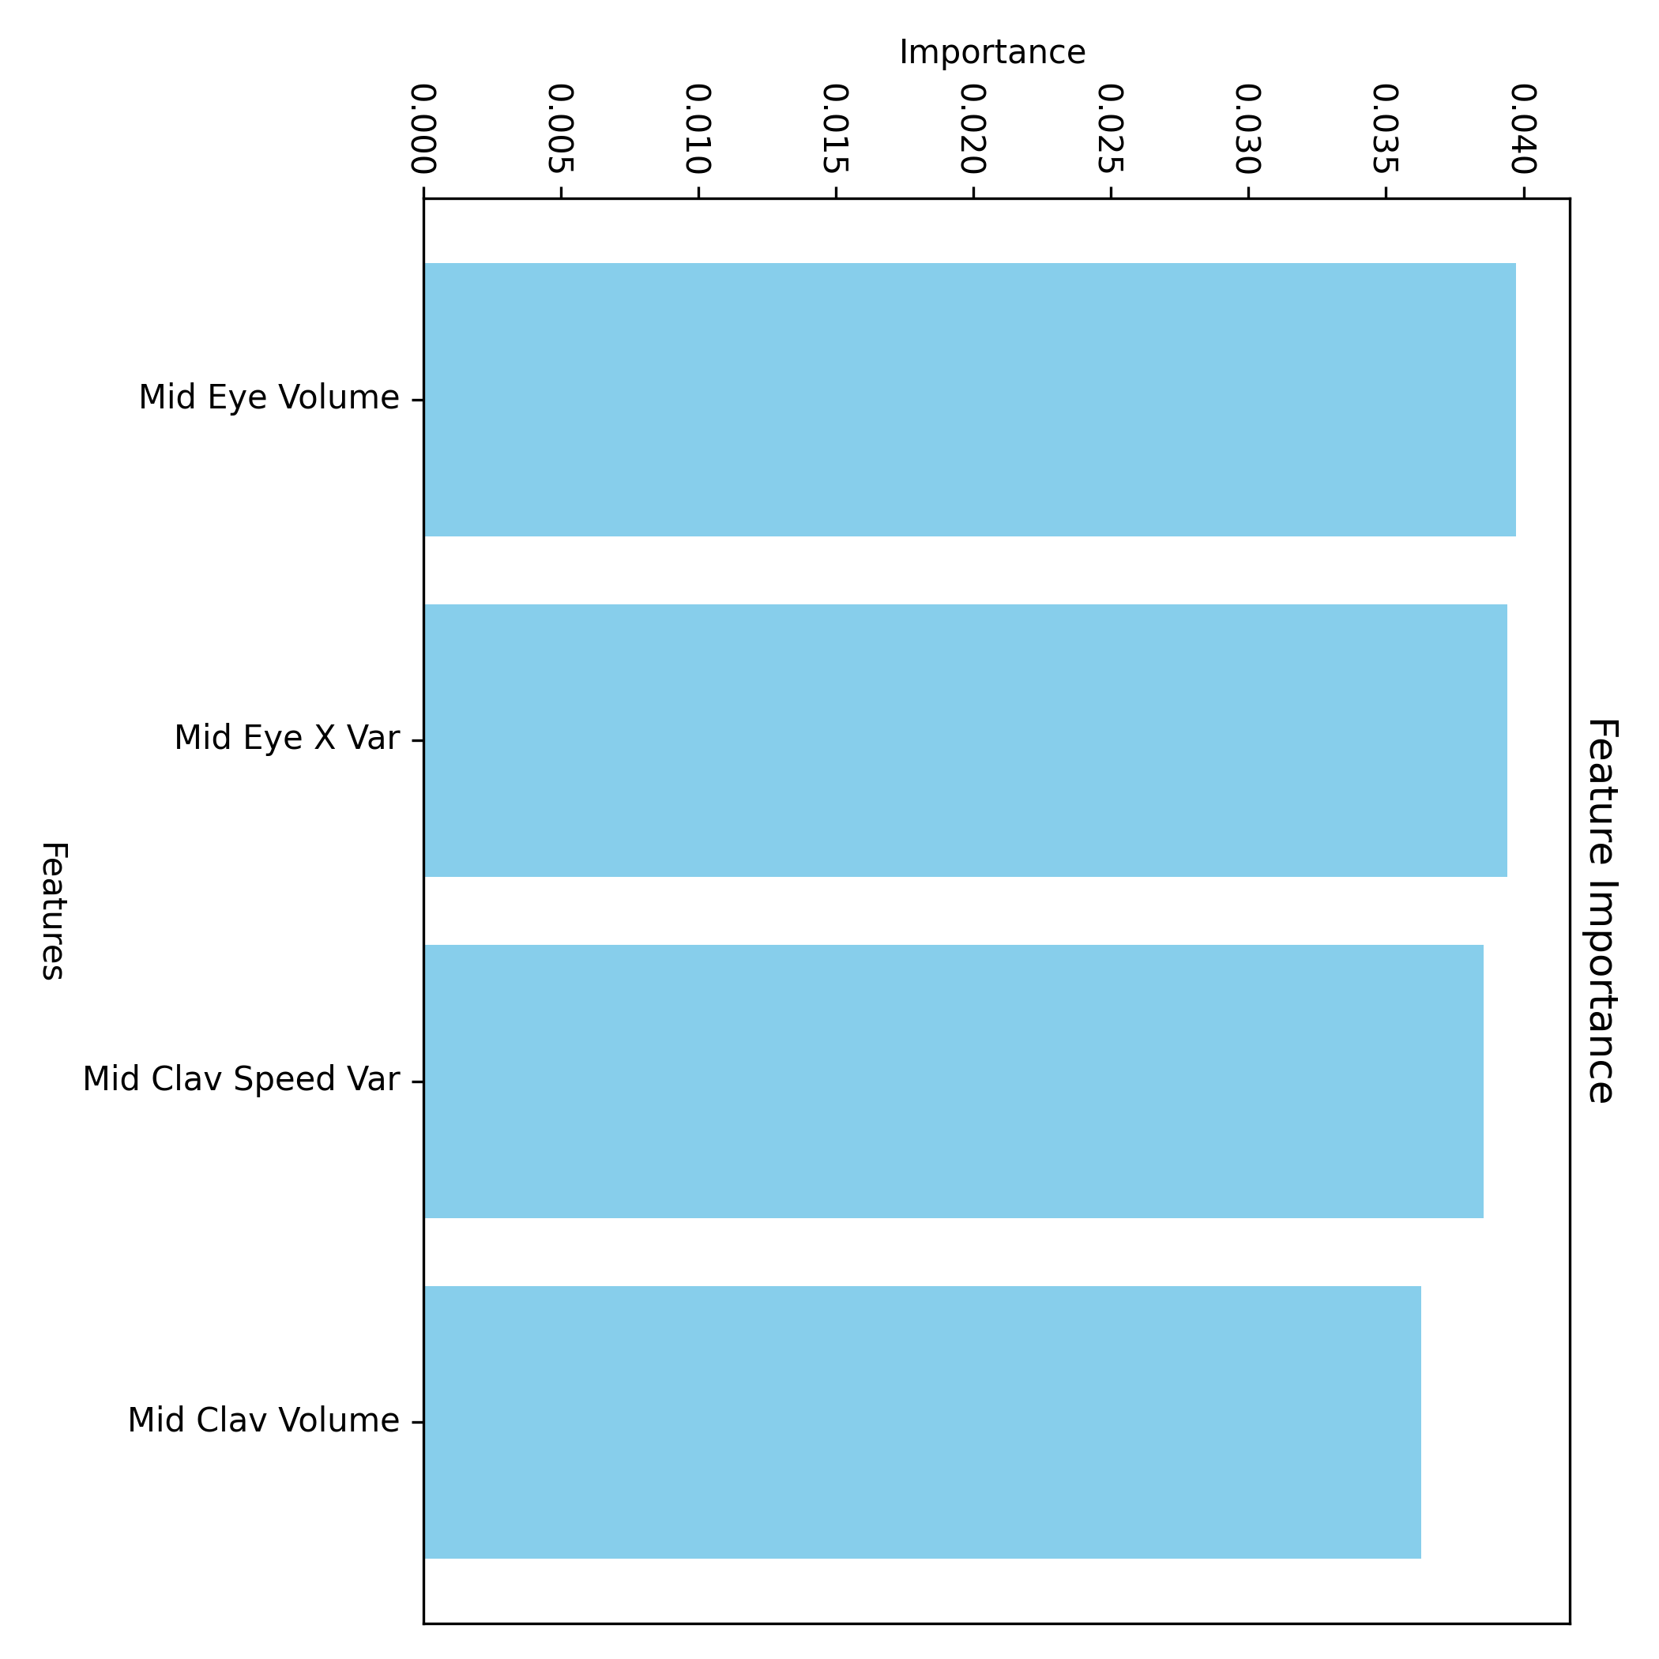
A separate classifier for signers (hearing, CODA speech) and speakers (deaf, CODA sign)

Slide 31
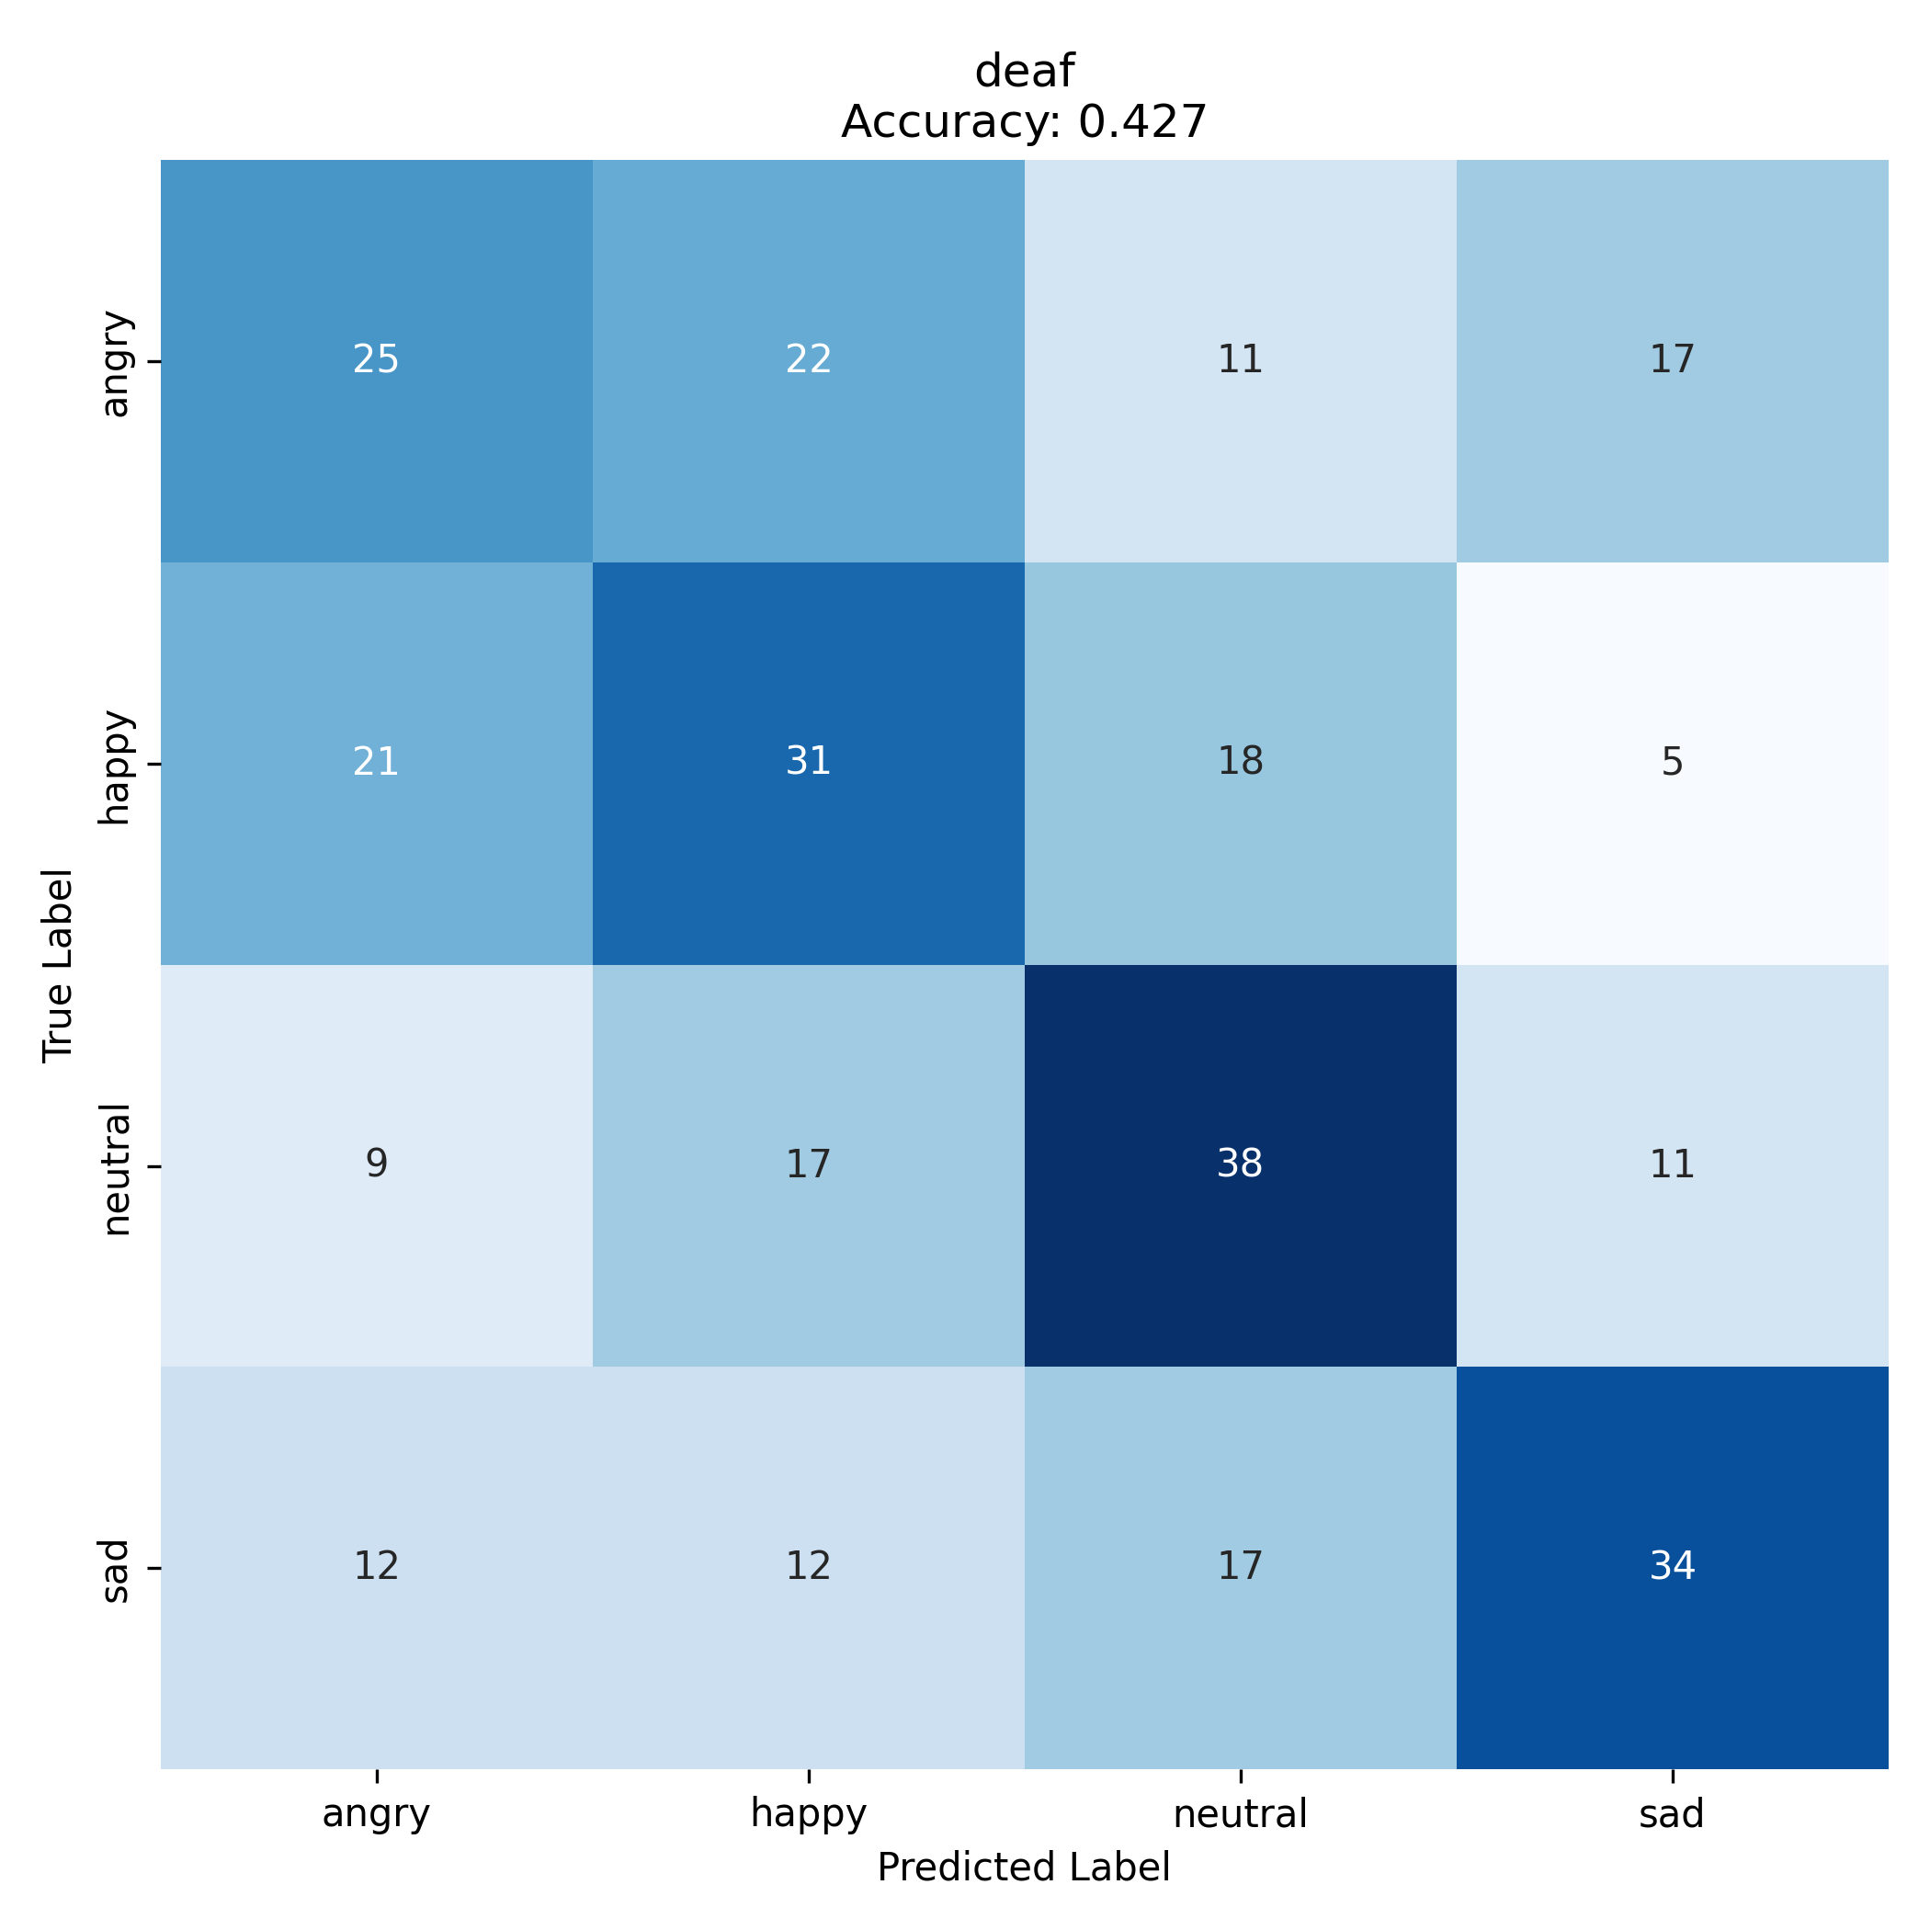
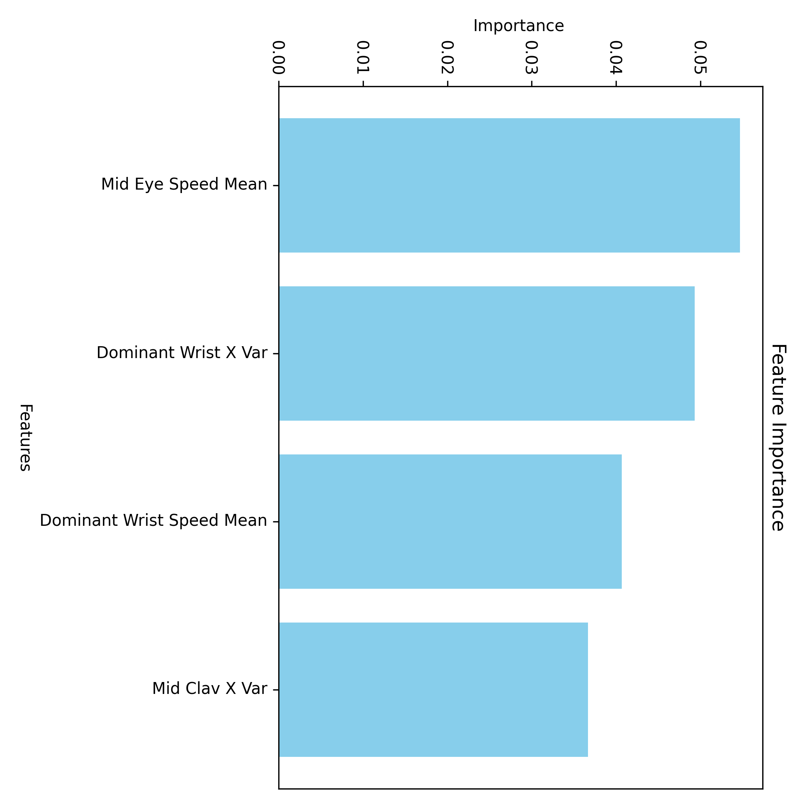
A separate classifier for each category (hearing, deaf, CODA speech, CODA sign)

